Slide 1

Data and Sentiment Analysis of Amazon Book Reviews
CIS 5200 – Term Project by Group 3

Slide 2
Team Members
Yougender Chauhan
Suman Chauhan
Nagender Chauhan
Viswanth Reddy Sama

Slide 3
Specifications
Cluster version : :HADOOP 3.1.2
Memory Size: 390.7 GB
Number of nodes : 5 nodes (2 Master & 3 Worker)
CPU Speed : 1995.309 MHz, 4 core CPU

Slide 4
Data Source URLs
Dataset URL: https://www.kaggle.com/datasets/mohamedbakhet/amazon-books-reviews?select=Books_rating.csv
Dictionary URL : https://github.com/dalgual/aidatasci/raw/master/data/bigdata/dictionary.tsv
GitHub URL :
https://github.com/Chauhan67/Amazonbookreviews/releases/download/v1/amazonbooks.zip

Slide 5

Project Summary

Slide 6

Architecture
Data Processing and Analysis
(Hive/beeline, Hadoop HDFS)
Data visualization
(Tableau & Excel)
Download Data
(Using SCP, get and bash terminal)
Data Source
(Kaggle)

Slide 7
Flowchart
Data Sourcing
Data Cleaning & Processing
Download analyzed dataset for visualization
Download the Amazon book review dataset from Kaggle.
Upload data using SCP to load into Linux server.
Upload Data into HDFS using put command.
Use Hive QL/Beeline to analyze dataset by creating external tables and views.
Implementing data analysis techniques such as Sentiment Analysis, N Gram. Explode etc
Export tables from Hive to HDFS and then finally to Linux server.
Download the exported file from Linux server to personal computer using SCP command for visualization in excel and tableau.
Download Dictionary file for sentiment Analysis using wget command.
Data Analysis

Slide 8
Data and Sentiment Analysis of Book reviews posted on Amazon
This project is to analyze the reviews of books posted on Amazon
Key Insights
Top ten most reviewed books(i.e., books with the greatest number of reviews)
Least rated book based on avg score (i.e., books with least star ratings)
Top 10 categories of books by count
N gram, context N gram analysis for most reviewed book (The Hobbit) and least reviewed book(Red Rabbit)
Sentiment Analysis for book review and summary

Slide 9
Why Amazon?
Amazon.com is originally found by Jeff Bezos in 1994 and has grown rapidly to become one of the most successful e-commerce businesses in the world.
With a rapid rate, Amazon.com has expanded in the world and has become one of the most popular retailing website in the world. The success is mainly due to its customer friendly website interface and innovative tools that aid the customers such as providing lists of best sellers, popular books and the recommendation system.
Reviews are generated in the corresponding product when the customers leave their feedback and rating on the website.

Slide 10
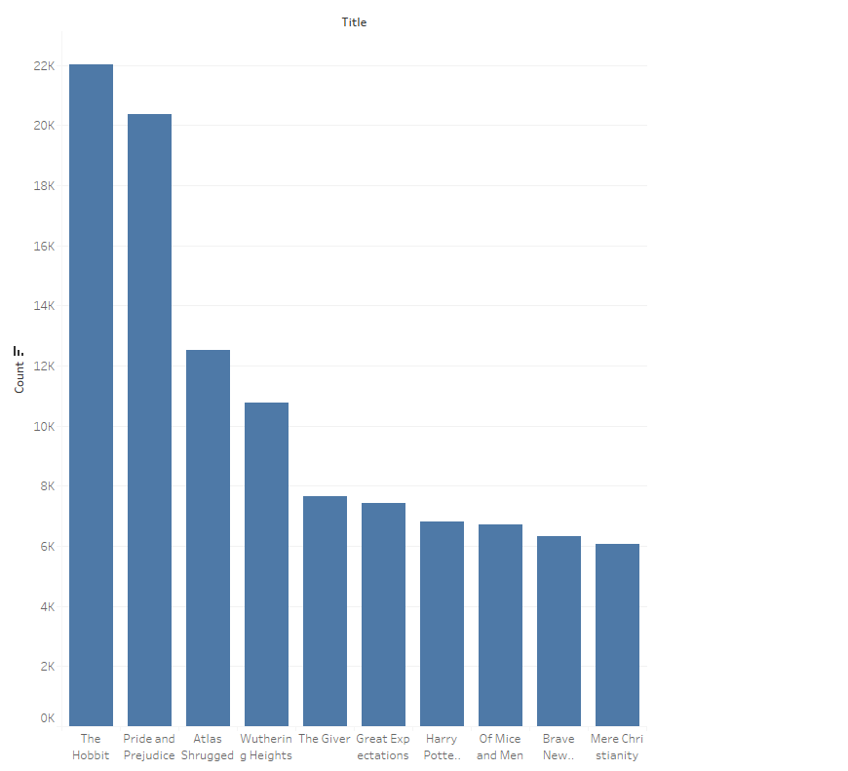
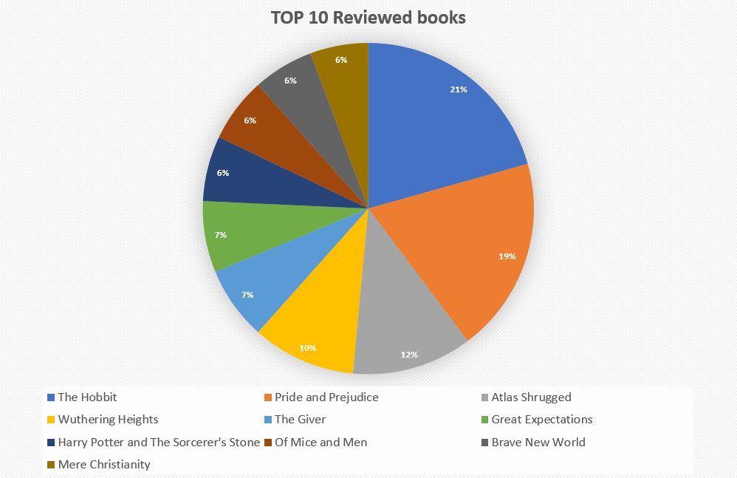
Hive Query & Visualization
Top ten most reviewed books(i.e., books with the greatest number of reviews)

Slide 11
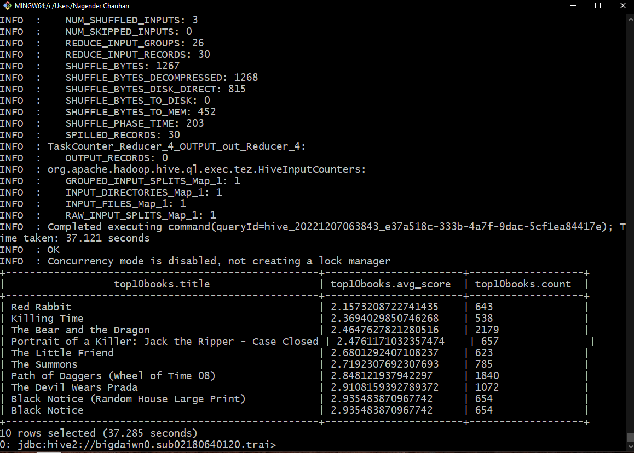
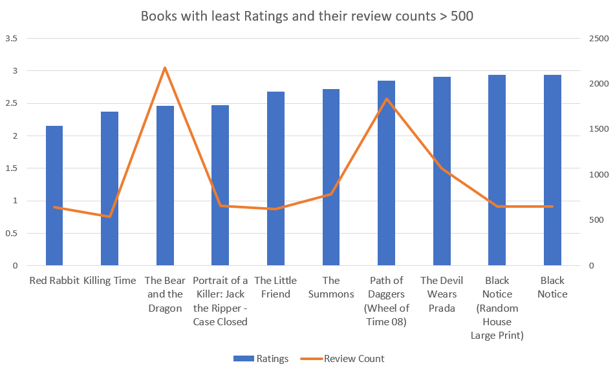
Hive Query & Visualization
Least rated book based on avg score (i.e., books with least star ratings)

Slide 12
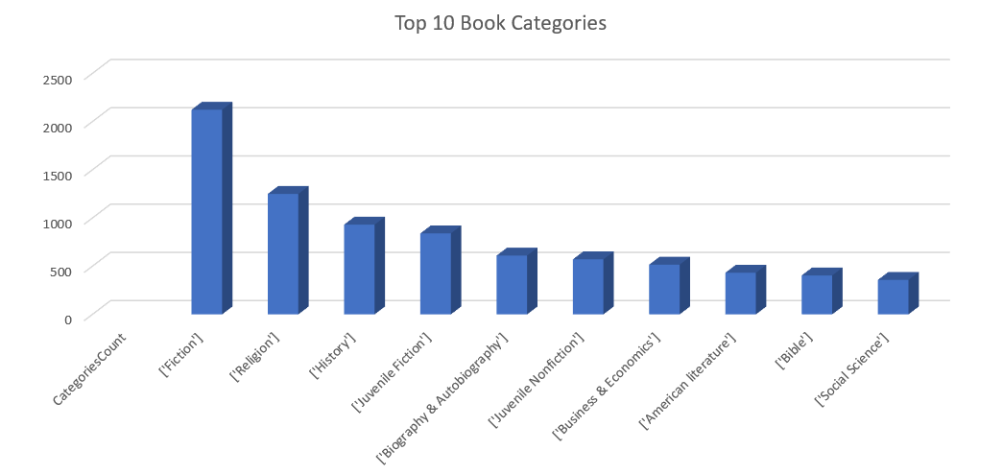
Hive Query & Visualization
Top 10 categories of books by count

Slide 13
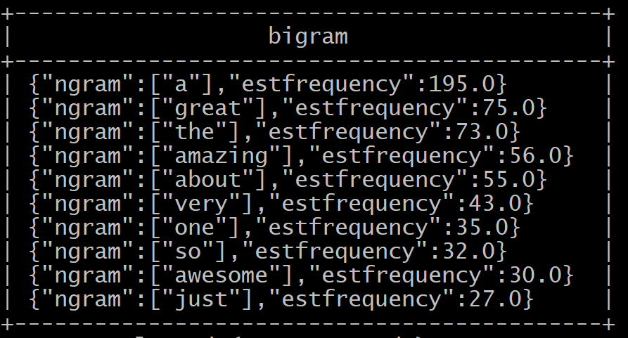
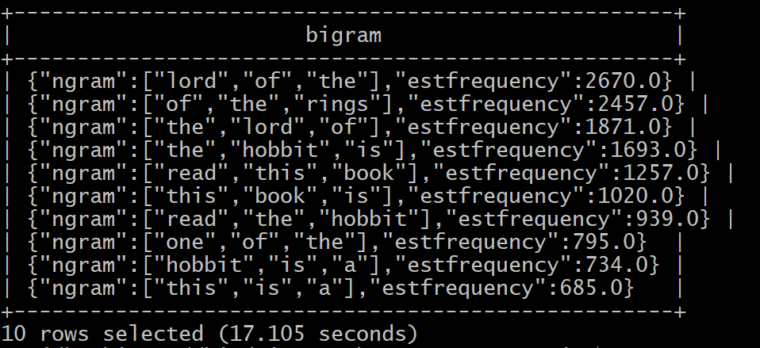
Hive Query & Visualization
N gram, context N gram analysis for most reviewed book (The Hobbit)

Slide 14
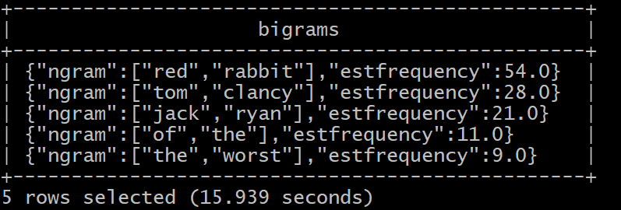
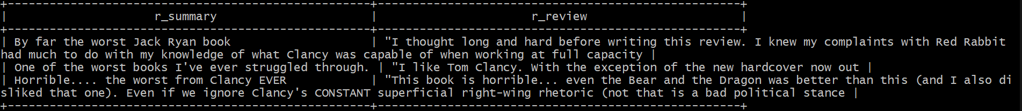
Hive Query & Visualization
N gram, context N gram analysis for least reviewed book(Red Rabbit)

Slide 15
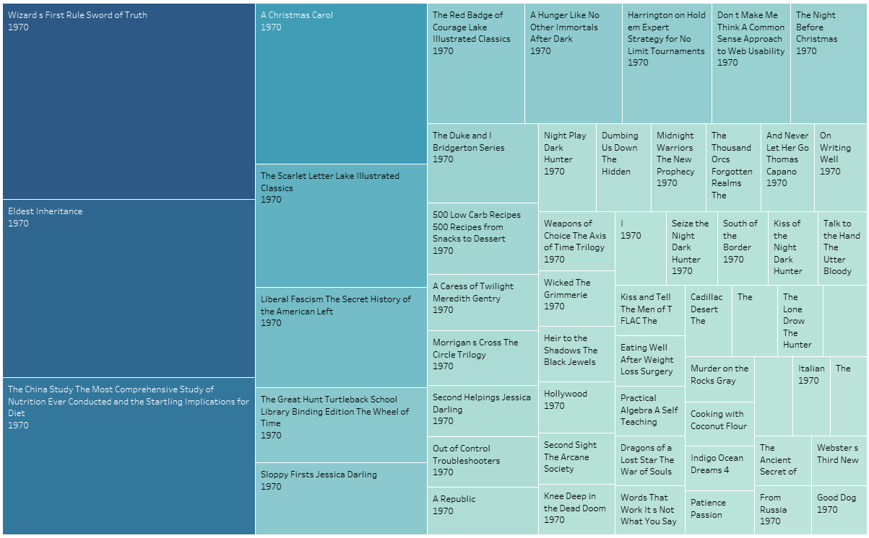
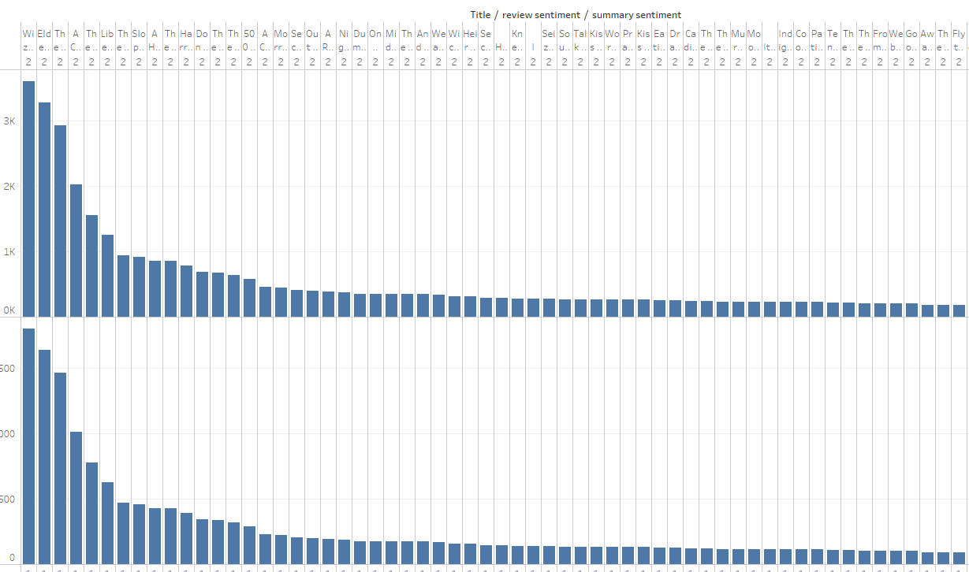
Sentiment Analysis
Sentiment Analysis of review text and review summary

Slide 16
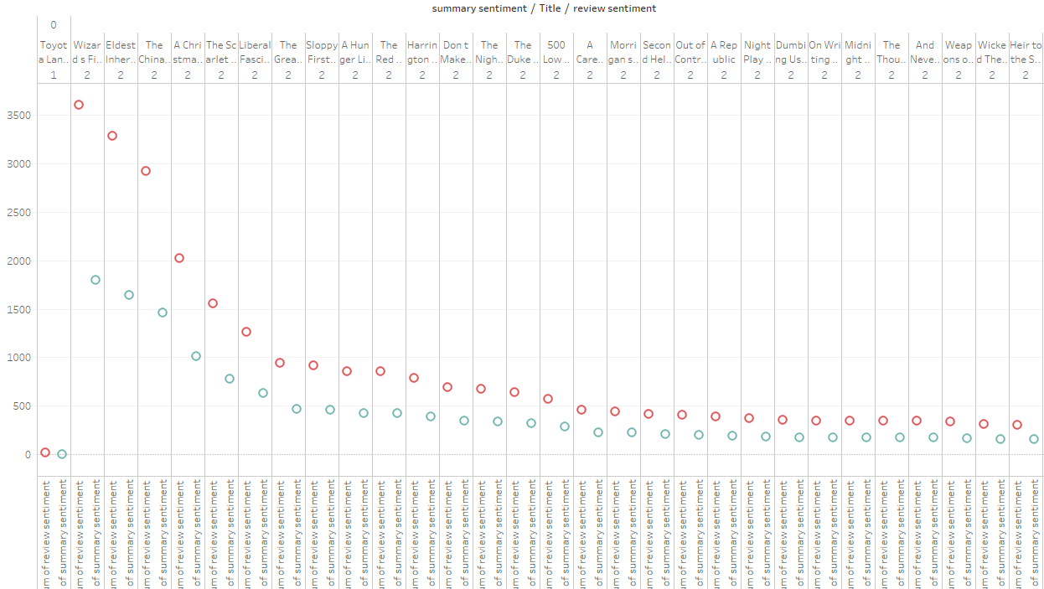
Sentiment Analysis
Sentiment Analysis Deviation of Review text and Review Summary

Slide 17
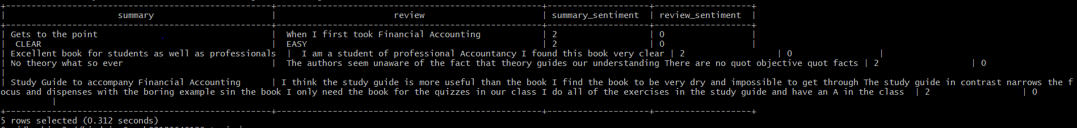
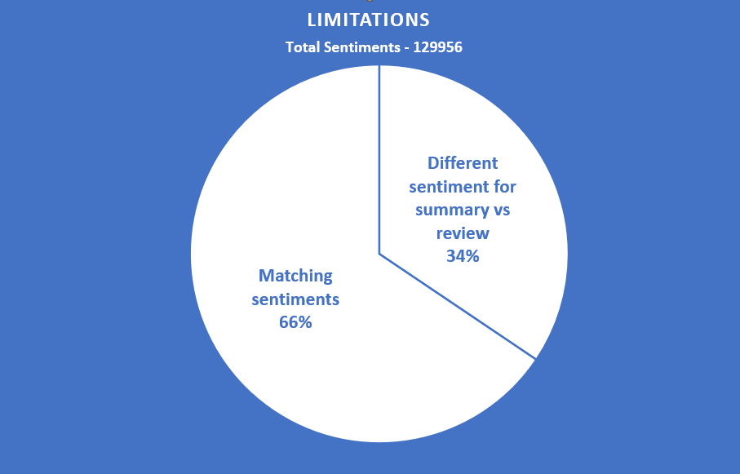
Sentiment Analysis
Limitations

Slide 18
Data Description
Size of Dataset : 2.9GB
(Books_rating.csv & books_data.csv)
Books_rating.csv has information about 3M book reviews for 212404 unique book and users who gives these reviews for each book.
books_data.csv has details of 212404 books such as genres, authors, cover, description etc.

Slide 19
GitHub Project URL
GitHub URL :
https://github.com/Chauhan67/Amazonbookreviews

Slide 20

Any Questions?

Slide 21


